Slide 1
SQL Server/EF Bad Practices
SQL SERVER is a RDBMS. Hence, writing proper SQL/EF functions that leverage the indexes will greatly improve query performance.

Slide 2
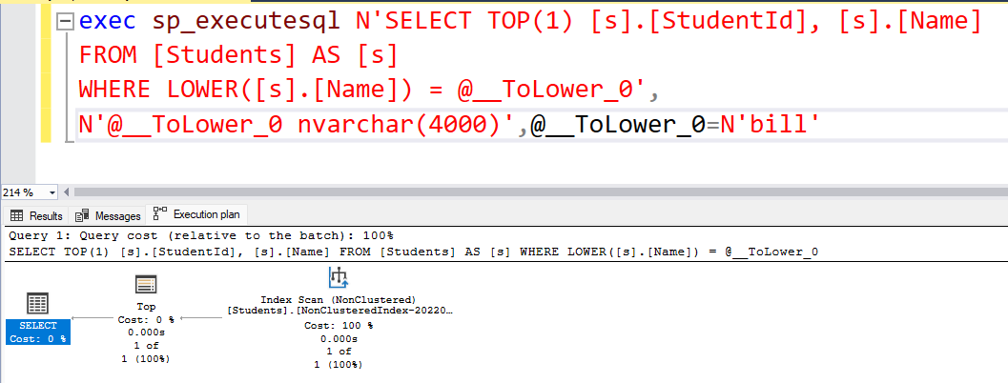
Do not use function on table’s column
Line no 24 using a ToLower() function on Name column resulting a table scan on student tables even though the table already has an index created on Name column. It is ok to have the tolower at the key variable because it is not part of the table. The s.Name!.Tolower() cause a table scan operator which scanning the whole table.

Slide 3
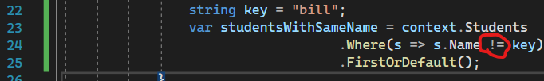
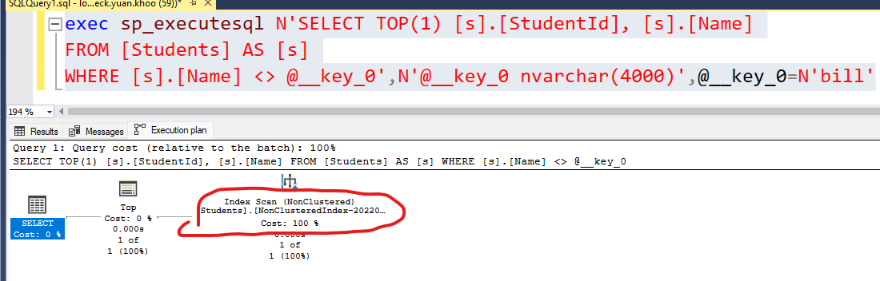
Do not use Inequality !=
Line 24 using inequality operator which will cause index scan. Inequality preventing index usage.

Slide 4
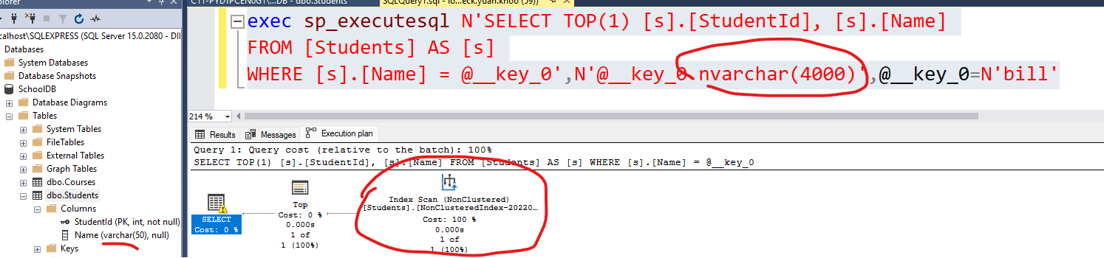
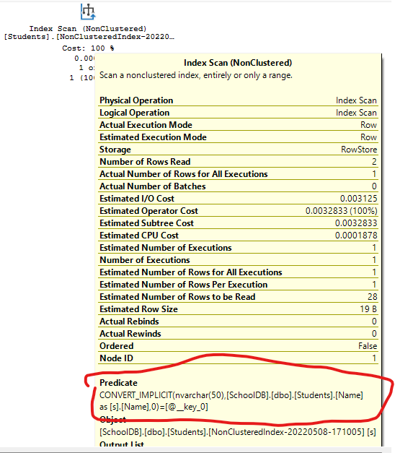
Datatype mismatch
Make sure the datatype of the column matching with variable datatype else it will cause a parsing function which trying to convert the Name column of varchar datatype into nvarchar which is an expensive activity. As a developer we need to make sure the datatype of columns match with the datatype of our queries.

